Slide 1
Project 1 Analysis of SAT & ACT Participation Rates
Kenneth Goh

Slide 2
Problem Statement
The new format for the SAT was released in March 2016 in a bid to increase participation rate. Since then, levels of participation in multiple states have changed with varying legislative decisions. This project aims to explore trends in the participation rates of the SAT and ACT tests for the three-year period (2017-2019) and seeks to identify regions/states that have the lowest SAT participation rates as potential high growth areas.

Slide 3
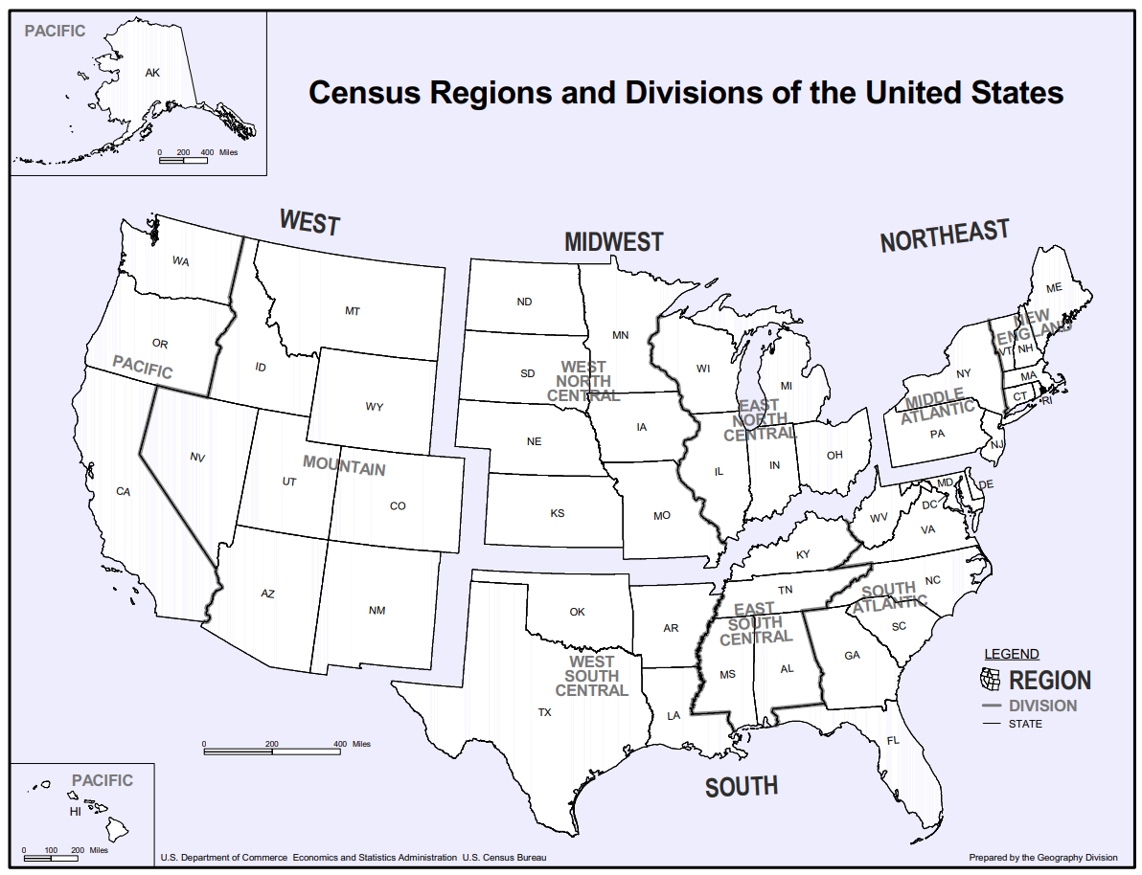
About the Dataset Used
ACT and SAT participation data for 2017, 2018, and 2019
Data from 51 states were included in the analysis (Virgin Islands and Puerto Rico were excluded due to missing data)
The states were classified into 4 geographical regions (West, Midwest, Northeast, South)
Source: us_regdiv.pdf (census.gov)

Slide 4
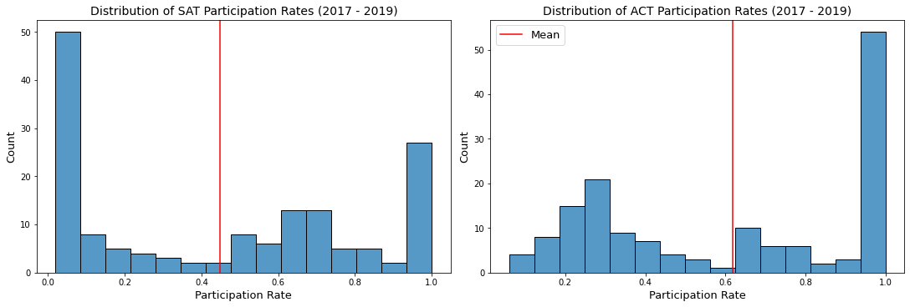
Overall, ACT recorded higher mean participation rate (62%) than SAT (45%) over the 3-year period. SAT has high number of observations (~50) with very low participation rates (<10%)
Mean = 0.45
Mean = 0.62
A large number of observations (~50) recorded the lowest participation rate (<10%) and the highest participation rate (>90%) (~25 counts)
A large number of observations (>50) recorded >90% participation rate
In contrast, there were not many observations with very low participation rate (<10%) as compared to SAT
Notes:
We will look at the analysis from the data set.

Slide 5
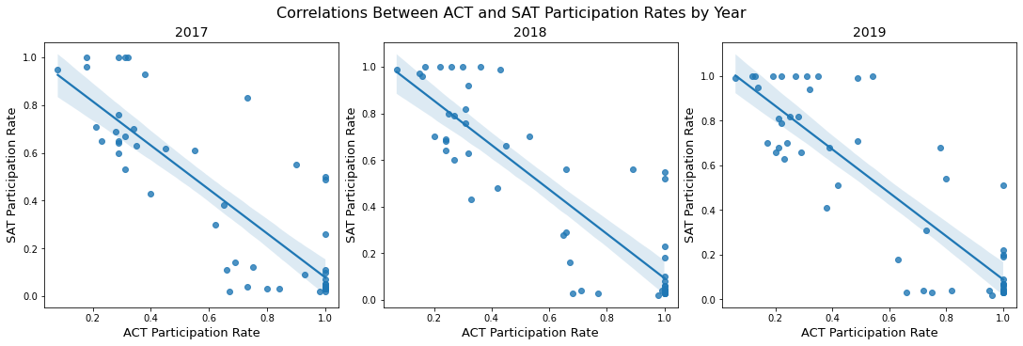
Strong negative correlation between ACT and SAT participation rates (r <-0.8)
r = -0.841
r = -0.868
r = -0.865
This corroborates with reports that students would typically take only one test – the one that meets their graduation requirements as mandated by the state, or college admission requirements.

Slide 6
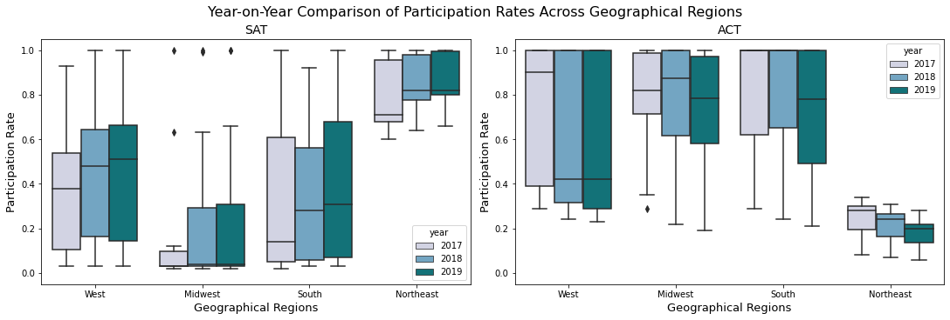
Midwest records significantly lower SAT participation rates as compared to other regions
Midwest is identified as a suitable target area to increase the SAT participation rate
Notes:
Next, we compare the participation rates across geographical regions.
Participation rate in the Midwest is significantly lower than the rest for 3 years
The plot also reflects the inverse relationship – low participation in SAT, high participation in ACT - most clearly shown for the Northeast
Midwest identified as a suitable area to target to increase the participation rate

Slide 7
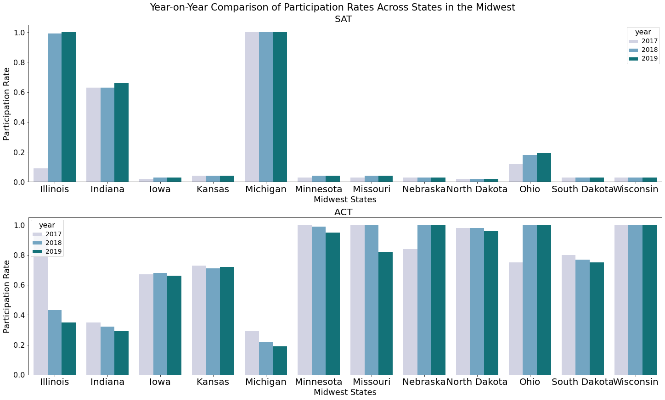
9 out of 12 Midwest states had recorded <20% participation for SAT test. In contrast, these states had >70% participation for ACT test. There is high growth potential in this region
SAT is mandatory for graduating students in Illiois and Michigan, hence the high participation rate (~100%); ACT is mandatory in Wisconsin
Otherwise, students in Midwest typically take the ACT test
With very low participating rates for SAT as a baseline, these states have very high growth potential
Potential number of gradutating students a year (8 states): ~356,000 (excl. Wisconsin)
Source: Knocking at the College Door | 9th Edition | 2016 - WICHE
Notes:
Next, we zoom into the Midwest, and found that 9 out of the 12 states have recorded <20% participation for SAT test.
Illiois and Michigan – mandatory SAT; Wisconsin – mandatory ACT
Students in the remaining states typically take ACT
Low baseline = high growth potential
8 states combined = 356,000 students

Slide 8
Recommendations
01
02
03
Collaborate with Education Boards
Increase outreach to students
Free preparation resources
Promote the use of SAT as a standardised test within the states identified for graduating students through the respective Education Boards
Conduct promotional talks/ roadshows to inform students of the new format and how they would benefit from it. Provide information on how it compares with the popular ACT test
Extend the existing free preparation resources to paying test takers as well. If students feel well-supported with the resources, and are confident of scoring well, they would likely choose to take SAT over ACT

Slide 9
End
Thank You

